Slide 1
Module 5: Network Fundamentals
Instructor Materials
DevNet Associate v1.0
Notes:
Cisco Networking Academy Program
DevNet Associate v1.0
Module 5: Network Fundamentals

Slide 2
Instructor Materials – Module 5 Planning Guide
This PowerPoint deck is divided in two parts:
Instructor Planning Guide
Information to help you become familiar with the module
Teaching aids
Instructor Class Presentation
Optional slides that you can use in the classroom
Begins on slide # 9
Note: Remove the Planning Guide from this presentation before sharing with anyone.
For additional help and resources go to the Instructor Home Page and Course Resources for this course. You also can visit the professional development site on www.netacad.com, the official Cisco Networking Academy Facebook page, or Instructor Only FB group.
Notes:
2

Slide 3
What to Expect in this Module
To facilitate learning, the following features within the GUI may be included in this module:
Feature | Description
PT Activity | Simulation and modeling activities designed to explore, acquire, reinforce, and expand skills.
Hands-On Labs | Labs designed for working with physical equipment.
Module Quizzes | Self-assessments that integrate concepts and skills learned throughout the series of topics presented in the module.
Module Summary | Briefly recaps module content.

Slide 4
Check Your Understanding
Check Your Understanding activities are designed to let students quickly determine if they understand the content and can proceed, or if they need to review.
Check Your Understanding activities do not affect student grades.
There are no separate slides for these activities in the PPT. They are listed in the notes area of the slide that appears before these activities.
Notes:
4

Slide 5
Module 5: Activities
What activities are associated with this module?
Page # | Activity Type | Activity Name | Optional?
5.4.6 | Packet Tracer | Explore a Simple Network | Recommended
5.5.7 | Packet Tracer | Explore Network Protocols | Recommended
5.6.6 | Packet Tracer | Troubleshoot Common Network Problems | Recommended
5.6.7 | Lab | Network Troubleshooting Tools | Recommended
Notes:
5

Slide 6
Module 5: Best Practices
Prior to teaching Module 5, the instructor should:
Review the activities and assessments for this module.
Try to include as many questions as possible to keep students engaged during classroom presentation.
Topic 5.1
Ask the participants to share their understanding of a network and its basic components.
Show a figure of the OSI model and the TCP/IP model given in the course and then discuss about each layers in both models.
Topic 5.2
Probe what the learners know about Network Topology.
Explain Ethernet.
Explain how MAC addresses identify physical devices on the network.
Discuss the uses of switches and then explain the switching process with the help of an example.
Notes:
6

Slide 7
Module 5: Best Practices (Contd.)
Topic 5.3
Enquire if the learners know about IP addresses and their types.
Explain addressing and routing with the help of some examples and ask the participants to discuss their basic understanding.
Topic 5.4
Explain to the class how switches connect devices on the network and routers route the trafﬁc between different networks.
Familiarise the class with the concept of a firewall and explain how a firewall prevents unauthorized access into or out of a network.
Bring on the topic of load balancers and discuss how they improve the distribution of workload.
Ask the class if they are familiar with network diagrams and then conduct a discussion on the same.
Notes:
7
Is

Slide 8
Module 5: Best Practices (Contd.)
Topic 5.5
Explain the standard network protocols.
Introduce DHCP relay and explain its operations.
Explain what Network Address Translation (NAT) is and how it helps with the problem of IPv4 address depletion.
Topic 5.6
Probe if the learners know about any common network connectivity issues and then explain how the networking tools and utilities can be used to resolve them.
Notes:
8

Slide 9
Module 5: Network Fundamentals
DevNet Associate v1.0
Notes:
Cisco Networking Academy Program
DevNet Associate v1.0
Module 5: Network Fundamentals
In-Session Activities / Explanations:
Time: 5 min
Instructor Notes:
Start the session by introducing the topic and encouraging the learners to come up with a list of expectations from the session.
To build the context of the module, ask the audience what they know about network protocols and their purpose.
As a NetAcad student, they must be knowing about network operations. Interact with them to refresh their memory about network fundamentals.
Read out the Objectives and briefly describe each.
Key Points:
NA

Slide 10
Module Objectives
Module Title: Network Fundamentals
Module Objective: Apply the processes and devices that support network connectivity.
Topic Title | Topic Objective
Introduction to Network Fundamentals | Explain basic network terms and processes.
Network Interface Layer | Explain the features and functions of the OSI network layer.
Internetwork Layer | Explain the features and functions of the OSI internetwork layer.
Network Devices | Explain the features and functions of common network devices.
Networking Protocols | Explain common networking protocols.
Troubleshooting Application Connectivity Issues | Troubleshoot basic network connectivity.
Notes:
10
DevNet Associate v1.0
5 – Network Fundamentals
5.0 – Introduction
5.0.2 – What Will I Learn to Do in this Module?

Slide 11
5.1 Introduction to Network Fundamentals
Notes:
Source:
5 – Network Fundamentals
5.1 – Introduction to Network Fundamentals
In-Session Activities / Explanations:
Time: 7 min
Instructor Notes:
Introduce the topic and discuss network fundamentals.
Ensure that the learners have knowledge about OSI model and TCP/IP model.
By the end of the topic, ensure that the learners understand data flow in layered models.
Key Points: Network, LAN, Ethernet, TCP/IP, OSI Model, Data Encapsulation, Data Flow in layered models

Slide 12
Network Fundamentals Overview
Knowing how to troubleshoot network connectivity is crucial to both developers and administrators, so quicker resolutions to problems is critical for everyone.
A high-level understanding of the layers, that the network trafﬁc goes through, provides a basic knowledge needed to work on networks, applications, and automation.
Notes:
5 – Network Fundamentals
5.1 – Introduction to Network Fundamentals
5.1.1 – Overview

Slide 13
Network Fundamentals What Is a Network?
A network consists of end devices such as computers, mobile devices and printers that are connected by networking devices such as switches and routers.
The network enables the devices to communicate with one another and share data.
The most common LAN methods to connect to a network are wired Ethernet LANs (IEEE 802.3) or wireless LANs (IEEE 802.11). The end-devices connect to the network using an Ethernet or wireless network interface card (NIC).
Protocol Suite
A protocol suite is a set of protocols that work together to provide comprehensive network communication services such as:
Internet Protocol Suite or TCP/IP
Open Systems Interconnection (OSI) protocols
AppleTalk (now replaced by TCP/IP)
Novell NetWare (now replaced by TCP/IP)
Notes:
5 – Network Fundamentals
5.1 – Introduction to Network Fundamentals
5.1.2 – What Is a Network?

Slide 14
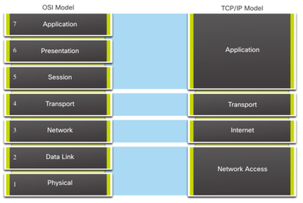
Network Fundamentals What Is a Network? (Contd.)
Both, OSI model and the TCP/IP model use layers to describe the functions and services that can occur at that layer.
Both models can be used with the following differences:
OSI model numbers each layer.
TCP/IP model uses a single application layer to refer to the OSI application, presentation, and session layers.
TCP/IP model uses a single network access layer to refer to the OSI data link and physical layers.
TCP/IP model refers to the OSI network layer as the Internet layer.
Notes:
5 – Network Fundamentals
5.1 – Introduction to Network Fundamentals
5.1.2 – What Is a Network?

Slide 15
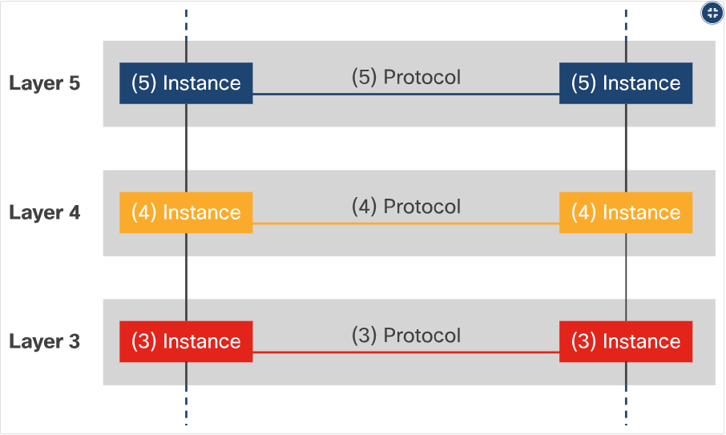
Network Fundamentals What Is a Network? (Contd.)
OSI Layer Data Communication
The form that a piece of data takes at any layer is called a Protocol Data Unit (PDU).
During encapsulation, each succeeding layer encapsulates the PDU that it receives from the layer above in accordance with the protocol being used.
When messages are sent on a network, the encapsulation process works from top to bottom.
Notes:
5 – Network Fundamentals
5.1 – Introduction to Network Fundamentals
5.1.2 – What Is a Network?

Slide 16
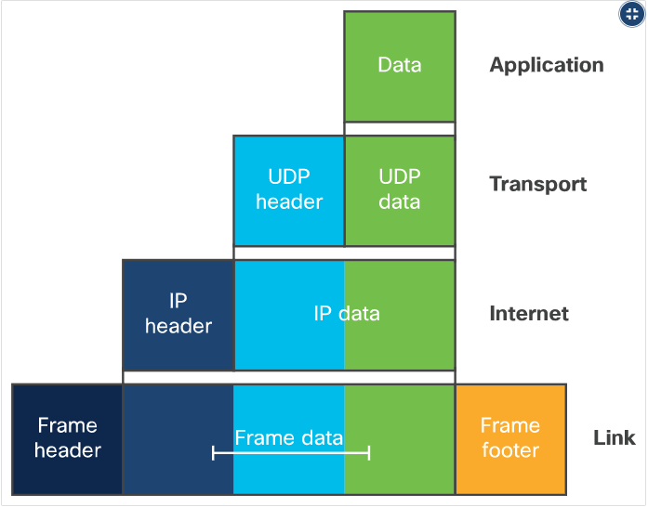
Network Fundamentals What Is a Network? (Contd.)
Data Encapsulation at Each Layer of the TCP/IP model
At each stage of the process, a PDU has a different name to reflect its new functions. The PDUs are named according to the following layers:
Data - The general term for the PDU used at the application layer
Segment - Transport layer PDU
Packet - Network layer PDU
Frame - Data Link layer PDU
Bits - Physical layer PDU used when physically transmitting data over the medium
Note: An OSI model layer is often referred to by its number.
Notes:
5 – Network Fundamentals
5.1 – Introduction to Network Fundamentals
5.1.2 – What Is a Network?

Slide 17
Network Fundamentals What Is a Network? (Contd.)
An application uses a set of protocols to send the data from one host to the other. Going down the layers, from the top one to the bottom one in the sending host and then the reverse path from the bottom layer all the way to the top layer on the receiving host, at each layer the data is being encapsulated.
At each layer, protocols perform the functionality required by that speciﬁc layer.
Notes:
5 – Network Fundamentals
5.1 – Introduction to Network Fundamentals
5.1.2 – What Is a Network?

Slide 18
Network Fundamentals What Is a Network? (Contd.)
Functionality of each layer of the OSI model:
Layer | Functionality
Physical Layer (Layer 1) | Responsible for the transmission and reception of raw bit streams.
Data Link Layer (Layer 2) | Provides NIC-to-NIC communications on the same network.
Network Layer (Layer 3) | Provides addressing and routing services to allow end devices to exchange data across networks.
Transport Layer (Layer 4) | Defines services to segment, transfer, and reassemble the data for individual communications between the end devices.
Session Layer (Layer 5) | Allows hosts to establish sessions between them.
Presentation Layer (Layer 6) | Speciﬁes context between application-layer entities.
Application Layer (Layer 7) | This is the OSI layer that is closest to the end user and contains a variety of protocols needed by users.
Notes:
5 – Network Fundamentals
5.1 – Introduction to Network Fundamentals
5.1.2 – What Is a Network?

Slide 19
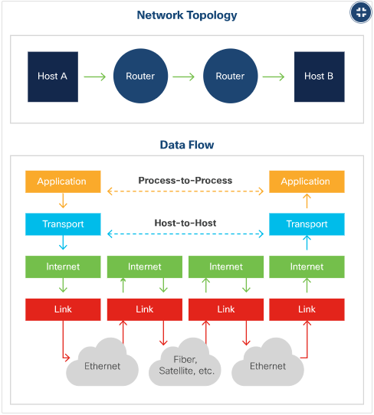
Network Fundamentals What Is a Network? (Contd.)
Data Flow in Layered Models
End devices implement protocols for the entire stack of layers.
The network access layer (shown as Link in the figure) operates at the local network connection to which an end-device is connected.
The internet layer is responsible for sending data across potentially multiple distant networks.
IP operates at the internet layer in the TCP/IP reference model and performs the two basic functions, addressing and routing.
Notes:
5 – Network Fundamentals
5.1 – Introduction to Network Fundamentals
5.1.2 – What Is a Network?

Slide 20
Network Fundamentals What Is a Network? (Contd.)
Planes of a Router
The logic of a router is managed by three functional planes:
Management Plane - This manages traffic destined for the network device itself.
Control Plane - This processes the traffic that is required to maintain the functionality of the network infrastructure. It consists of applications and protocols and processes data in software.
Data Plane - This is the forwarding plane that is responsible for switching of packets in hardware, using information from the control plane.
Notes:
5 – Network Fundamentals
5.1 – Introduction to Network Fundamentals
5.1.2 – What Is a Network?

Slide 21
5.2 Network Interface Layer
Notes:
Source:
5 – Network Fundamentals
5.2 – Network Interface Layer
In-Session Activities / Explanations:
Time: 7 min
Instructor Notes:
Introduce the topic and discuss how devices are interconnected in a network.
Briefly explain to the learners about Ethernet and MAC addresses.
Help the learners get familiar with switching and its process.
By the end of the topic, ensure that the learners have knowledge about Virtual LANs (VLANs).
Key Points: Ethernet, MAC addresses, switching, vLANs, Network Topology

Slide 22
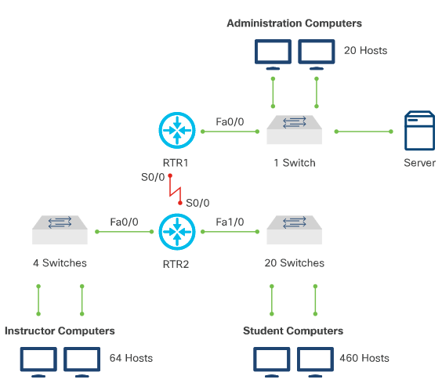
Network Interface Layer Understanding the Network Interface Layer
Network Topology
The network enables the devices to communicate with one another and share data.
All host and network devices that are interconnected, within a close physical area, form a local area network (LAN).
Network devices that connect LANs, over large distances, form a wide area network (WAN).
Notes:
5 – Network Fundamentals
5.2 – Network Interface Layer
5.2.1 – Understanding the Network Interface Layer

Slide 23

Network Interface Layer Ethernet
Ethernet is a set of guidelines published by the IEEE that specify cabling and signaling at the physical and data link layers of the OSI model.
Ethernet Frame
The container in which data is placed for transmission is called a frame. Frame contains header information, trailer information, and the actual data that is being transmitted.
The most important ﬁelds of the Ethernet frame include:
Notes:
5 – Network Fundamentals
5.2 – Network Interface Layer
5.2.2 – Ethernet

Slide 24
Network Interface Layer Ethernet (Contd.)
MAC addresses are used in transporting a frame across a shared local media.
If the data (encapsulated IP packet) is for a device on another network, the destination MAC address will be that of the local router (default gateway).
The Ethernet header and trailer will be de-encapsulated by the router.
The packet will be encapsulated in a new Ethernet header and trailer using the MAC address of the router's egress interface as the source MAC address.
If the next hop is another router, then the destination MAC address will be that of the next hop router.
If the router is on the same network as the destination of the packet, the destination MAC address will be that of the end device.
Notes:
5 – Network Fundamentals
5.2 – Network Interface Layer
5.2.2 – Ethernet

Slide 25
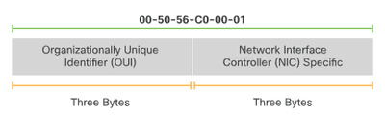
Network Interface Layer MAC Addresses
All network devices on the same network must have a unique MAC address.
The MAC address is the means by which data is directed to the proper destination device.
A MAC address is composed of 12 hexadecimal numbers. There are two main components of a MAC:
24-bit OUI - The OUI identifies the manufacturer of the NIC.
24-bit, vendor-assigned, end-station address - This portion uniquely identifies the Ethernet hardware.
Destination MAC addresses include the three major types of network communications:
Unicast
Broadcast
Multicast
Notes:
5 – Network Fundamentals
5.2 – Network Interface Layer
5.2.3 – MAC Addresses

Slide 26
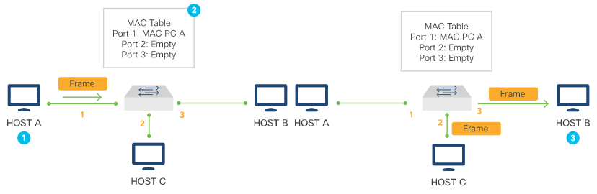
Network Interface Layer Switching
The switch dynamically builds and maintains a table (called the MAC address table) that matches the destination MAC address with the port that is used to connect to a node.
Switching Process
In the first topology, the switch receives a frame from Host A on port 1.
The switch enters the source MAC address and the switch port that received the frame into the MAC address table. The switch checks the table for the destination MAC address. As the destination address is not known, the switch floods the frame to all of the ports except the port on which it received the frame.
In the second topology, Host B, the destination MAC address, receives the Ethernet frame.
Notes:
5 – Network Fundamentals
5.2 – Network Interface Layer
5.2.4 – Switching

Slide 27
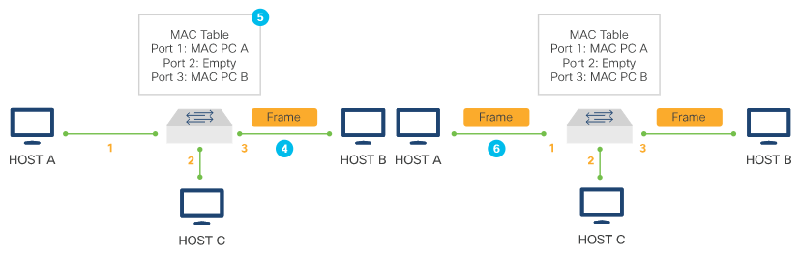
Network Interface Layer Switching (Contd.)
In the third topology, Host B replies to Host A with the destination MAC address of Host A.
The switch enters the source MAC address of Host B and the port number of the switch port that received the frame into the MAC table. The destination address of the frame and its associated port is known in the MAC address table.
In the fourth topology, the switch can now directly forward this frame to Host A out port 1. Frames between the source and destination devices are sent without flooding because the switch has entries in the MAC address table that identify the associated ports.
Notes:
5 – Network Fundamentals
5.2 –Network Interface Layer
5.2.4 – Switching

Slide 28
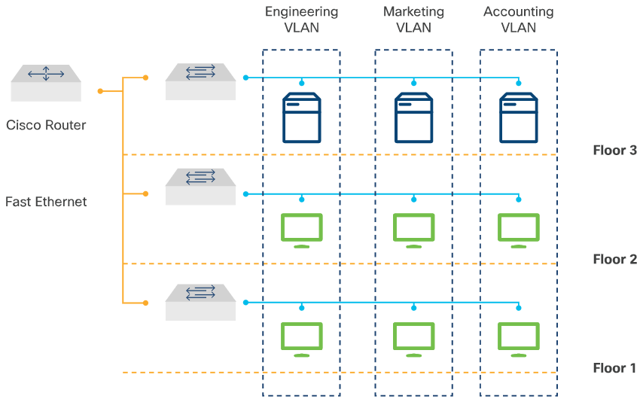
Network Interface Layer Virtual LANs (VLANs)
A virtual LAN (VLAN) is used to segment different Layer 2 broadcast domains on one or more switches.
A VLAN groups devices on one or more LANs that are conﬁgured to communicate as if they were attached to the same wire, when in fact they are located on a number of different LAN segments.
The figure shows three VLANs based on the function of its users: engineering, marketing, and accounting. It clearly shows that the devices do not need to be on the same floor.
Notes:
5 – Network Fundamentals
5.2 –Network Interface Layer
5.2.5 – Virtual LANs (VLANs)

Slide 29
Network Interface Layer Virtual LANs (VLANs) (Contd.)
VLANs deﬁne Layer 2 broadcast domains. VLANs on Layer 2 switches create broadcast domains based on the conﬁguration of the switch.
To interconnect two different VLANs, a router or Layer 3 switch must be used.
VLANs are often associated with IP networks or subnets.
The following table explains that the VLANs are organized into three ranges: reserved, normal, and extended.
VLANs | Range | Usage
0, 4095 | Reserved | For system use only. You cannot see or use these VLANs.
1 | Normal | Cisco default. You can use this VLAN, but you cannot delete it.
2 - 1001 | Normal | Used for Ethernet VLANs; you can create, use, and delete these VLANs.
1002 - 1005 | Normal | Cisco defaults for FDDI and Token Ring. You cannot delete VLANs 1002-1005.
1006 - 4094 | Extended | For Ethernet VLANs only.
Notes:
5 – Network Fundamentals
5.2 –Network Interface Layer
5.2.5 – Virtual LANs (VLANs)

Slide 30
5.3 Internetwork Layer
Notes:
Source:
5 – Network Fundamentals
5.3 – Internetwork Layer
In-Session Activities / Explanations:
Time: 10 min
Instructor Notes:
Give a brief introduction to the topic and discuss how internetworking provides communication method between networks.
Introduce what are IPv4 addresses and explain about IPv6 addresses.
Describe IPv6 unicast addresses to the learners.
Explain what are routers and how routing is done.
Key Points: IPv4, IPv6, unicast addresses, Routers.

Slide 31
Internetwork Layer Understanding the Internetwork Layer
Interconnected networks must have ways to communicate. Internetworking provides that between networks communication method.
Notes:
5 – Network Fundamentals
5.3 – Internetwork Layer
5.3.1 – Understanding the Internetwork Layer

Slide 32
Internetwork Layer IPv4 Addresses
Every device on a network has a unique IP address.
An IPv4 address is 32 bits, with each octet (8 bits) represented as a decimal value separated by a dot. This representation is called dotted decimal notation.
There are three types of IPv4 addresses:
Network address
Host addresses
Broadcast address
The IPv4 subnet mask (or prefix length) is used to differentiate the network portion from the host portion of an IPv4 address.
A network can be divided into smaller networks called subnets. Subnets can be provided to individual organizational units to simplify the network. The subnet provides a speciﬁc range of IP addresses for a group of hosts to use.
Devices using private IPv4 addresses are able to access the internet via Network Address Translation (NAT) and Port Address Translation (PAT).
Notes:
5 – Network Fundamentals
5.3 – Internetwork Layer
5.3.2 - IPv4 Addresses

Slide 33
Internetwork Layer IPv6 Addresses
IPv6 is designed to be the successor to IPv4. IPv6 has a larger 128-bit address space.
The architecture of IPv6 has been designed to allow existing IPv4 users to transition easily to IPv6 while providing services such as end-to-end security, quality of service (QoS), and globally unique addresses.
IPv6 preﬁx aggregation, simpliﬁed network renumbering, and IPv6 site multihoming capabilities provide an IPv6 addressing hierarchy that allows for more efﬁcient routing.
IPv6 address space eliminates the need for private addresses; therefore, IPv6 enables new application protocols that do not require special processing by border devices at the edge of networks.
IPv6 addresses are represented as a series of 16-bit hexadecimal ﬁelds (hextet) separated by colons (:) in the format: x:x:x:x:x:x:x:x. The preferred format includes all the hexadecimal values.
IPv6 addresses commonly contain successive hexadecimal ﬁelds of zeros. Two colons (::) may be used to compress these zeros at the beginning, middle, or end of an address.
A double colon (::) can replace any single, contiguous string of one or more 16-bit hextets consisting of all zeros.
Notes:
5 – Network Fundamentals
5.3 – Internetwork Layer
5.3.3 – IPv6 Addresses

Slide 34
Internetwork Layer IPv6 Unicast Addresses
An IPv6 unicast address is an identiﬁer for a single interface, on a single device.
A packet that is sent to a unicast address is delivered to the interface identiﬁed by that address.
There are several types of IPv6 unicast addresses including:
Global Unicast Address (GUA): This is an IPv6 similar to a public IPv4 address which is globally unique and routable on the IPv6 internet.
Link-Local Addresses (LLA): This enables a device to communicate with other IPv6-enabled devices on the same link and only on that link (subnet).
Unique Local Addresses: These are not yet commonly implemented. However, unique local addresses may eventually be used to address devices that should not be accessible from the outside, such as internal servers and printers.
Multicast Addresses: These are used instead of broadcast addresses to send a single packet to one or more destinations (multicast group). Note that the multicast addresses can only be destination addresses and not source addresses.
Note: There are other types of IPv6 unicast addresses besides the four mentioned above. These four are the most significant to for discussion in this course.
Notes:
5 – Network Fundamentals
5.3 – Internetwork Layer
5.3.4 – IPv6 Unicast Addresses

Slide 35
Internetwork Layer Routers and Routing
Router is a networking device that functions at the internet layer of the TCP/IP model or Layer 3 network layer of the OSI model.
Routers use a routing table to route between networks.
A router generally has two main functions:
Path Determination | Path determination is the process through which routers use their routing tables to determine where to forward packets. When a router receives an incoming packet, it checks the destination IP address in the packet and looks up the best match in its routing table. A matching entry indicates that the destination is directly connected to the router. That router becomes the next-hop router towards the ﬁnal destination of the packet. If there is no matching entry, the router sends the packet to the default route. If there is no default route, the router drops the packet.
Packet Forwarding | After the router determines the correct path for a packet, it forwards the packet through a network interface towards the destination network. A routing table may contain the following types of entries: Directly connected networks Static routes Dynamic routes Default routes
Notes:
5 – Network Fundamentals
5.3 – Internetwork Layer
5.3.5 - Routers and Routing

Slide 36
5.4 Network Devices
Notes:
Source:
5 – Network Fundamentals
5.4 – Network Devices
In-Session Activities / Explanations:
Time: 15 min
Instructor Notes:
Introduce the topic and discuss how the networking devices perform the switching and routing functions.
Introduce the concept of a firewall and explain how a firewall prevents unauthorized access into or out of a network.
Bring on the topic of load balancers and discuss how they improve the distribution of workload.
By the end of the topic, make the learners familiar with Network diagrams.
Key Points: Ethernet switches, routers, firewalls, load balancers, Network diagrams

Slide 37
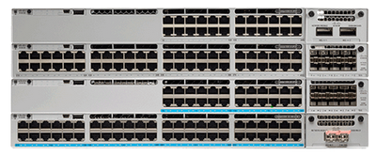
Network Devices Ethernet Switches
A key concept in Ethernet switching is the broadcast domain. A broadcast domain is a logical division in which all devices in a network can reach each other by broadcast at the data link layer.
Ethernet switches can simultaneously transmit and receive data. This mode is called full-duplex, which eliminates collision domains.
Switches have the following functions:
Operate at the network access layer of the TCP/IP model and the Layer 2 data link layer of the OSI model
Filter or flood frames based on entries in the MAC address table
Have a large number of high speed and full-duplex ports
The figure shows an example of switches with multiple high speed and full-duplex ports.
Notes:
5 – Network Fundamentals
5.4 – Network Devices
5.4.1 – Ethernet switches

Slide 38
Network Devices Ethernet Switches (Contd.)
The switch operates in either of the following switching modes:
Cut-Through Switching Mode – Switch forwards the data before receiving the entire frame by reading the destination details in the frame header thereby increasing switching speed.
Store-and-Forward Switching Mode – Switch receives the entire frame, checks for errors before forwarding it which makes this mode slower than cut-through mode.
Some characteristics of LAN switches are:
High port density - Switches have a large number of ports, from 24 to 48 ports per switch in smaller devices, to hundreds of ports per switch chassis in larger modular switches.
Large frame buffers - Switches have the ability to store received frames when there may be congested ports on servers or other devices in the network.
Fast internal switching - Switches have very fast internal switching. They are able to switch user traffic from the ingress port to the egress port extremely fast.
Notes:
5 – Network Fundamentals
5.4 – Network Devices
5.4.1 – Ethernet switches

Slide 39
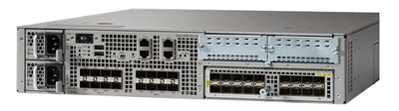
Network Devices Routers
Routers are needed to reach devices that are not on the same LAN and use routing tables to route trafﬁc between different networks.
Routers have the following functions:
They operate at the internet layer of TCP/IP model and Layer 3 network layer of the OSI model.
They route packets between networks based on entries in the routing table.
They have support for a large variety of network ports, including various LAN and WAN media ports.
The figure shows a modular router with integrated switch ports.
Notes:
5 – Network Fundamentals
5.4 – Network Devices
5.4.2 - Routers

Slide 40
Network Devices Routers (Contd.)
There are three packet-forwarding mechanisms supported by routers:
Process switching - When a packet arrives on an interface, it is forwarded to the control plane where the CPU matches the destination address with an entry in its routing table, and then determines the exit interface and forwards the packet. This mechanism is very slow and is rarely implemented in modern networks.
Fast switching - With fast switching, a routing cache mechanism is implemented. Fast switching uses a fast-switching cache to store next-hop information. The flow information for the packet is also stored in the fast-switching cache which means, if another packet of the same destination arrives, the next-hop information in the cache is re-used without CPU intervention.
Cisco Express Forwarding (CEF) - CEF is the most recent and default Cisco IOS packet-forwarding mechanism. CEF builds a Forwarding Information Base (FIB), and an adjacency table. The table entries are change-triggered that are based on changes in the network topology.
Notes:
5 – Network Fundamentals
5.4 – Network Devices
5.4.2 - Routers

Slide 41
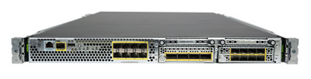
Network Devices Firewalls
A ﬁrewall is a hardware or software system that prevents unauthorized access into or out of a network.
Firewalls are used to prevent unauthorized internet users from accessing internal networks.
All data leaving or entering the protected intranet must pass through the ﬁrewall to reach its destination, and any unauthorized data is blocked.
The figure shows an example of a hardware firewall.
Notes:
5 – Network Fundamentals
5.4 – Network Devices
5.4.3 - Firewalls

Slide 42
Network Devices Firewalls (Contd.)
Stateless packet-ﬁltering
The most basic (and the original) type of ﬁrewall is a stateless packet-ﬁltering ﬁrewall.
The ﬁrewall examines packets as they traverse the ﬁrewall, compares them to static rules, and permits or denies trafﬁc accordingly.
This is based on several packet header ﬁelds, including the following:
Source and/or destination IP address
IP protocol ID
Source and/or destination TCP or UDP Port number
ICMP message type
This type of ﬁrewall works best for TCP applications that use the same static ports every time, or for ﬁltering that is based on Layer 3 information such as source or destination IP address.
Notes:
5 – Network Fundamentals
5.4 – Network Devices
5.4.3 - Firewalls

Slide 43
Network Devices Firewalls (Contd.)
Stateful packet-ﬁltering
This type of ﬁrewall performs header inspection and also keeps track of the connection state.
To keep track of the state, these ﬁrewalls maintain a state table.
Any sessions or trafﬁc initiated by devices on the trusted, inside networks are permitted through the ﬁrewall.
The ﬁrewall understands an initial request, and so an appropriate response from the server is allowed back in through the ﬁrewall. It will allow only valid response packets that come from the speciﬁc server.
The ﬁrewall understands standard TCP/IP packet ﬂow including the coordinated change of information between inside and outside hosts that occurs during the life of the connection.
These stateful ﬁrewalls are more adept at handling Layer 3 and Layer 4 security than a stateless device.
Notes:
5 – Network Fundamentals
5.4 – Network Devices
5.4.3 - Firewalls

Slide 44
Network Devices Firewalls (Contd.)
Application Layer Packet-Filtering
This is the most advanced type of ﬁrewall. The deep inspection of the packet occurs all the way up to the OSI model’s Layer 7.
This gives more reliable and capable access control for OSI Layers 3–7, with simpler conﬁguration.
The application layer ﬁrewall can determine an File Transfer Protocol (FTP) session, just like a stateless or stateful ﬁrewall can.
The ﬁrewall’s deeper packet inspection capability enables it to verify adherence to standard HTTP protocol functionality.
It can deny requests that do not conform to the standards or meet the criteria established by the security team.
Notes:
5 – Network Fundamentals
5.4 – Network Devices
5.4.3 - Firewalls

Slide 45
Network Devices Load Balancers
Load balancing improves the distribution of workloads across multiple computing resources, such as servers, cluster of servers, network links and so on.
Server load balancing helps ensure the availability, scalability, and security of applications and services by distributing the work of a single server across multiple servers.
At the device level, the load balancer provides the following features to support high network availability:
Device redundancy
Scalability
Security
At the network service level, a load balancer provides the following advanced services:
High services availability | Scalability | Services-level security
This allows distribution of client requests among physical servers and server farms. | Virtualization allows the use of advanced load-balancing algorithms to distribute client requests among the virtual devices. | This allows establishment and maintenance of a Secure Sockets Layer (SSL) session between the load balancer and its peer.
Notes:
5 – Network Fundamentals
5.4 – Network Devices
5.4.4 – Load Balancers

Slide 46
Network Devices Network Diagrams
Network diagrams are part of the documentation that goes with a network deployment and also play an important role when the documentation steps in programming code.
They display a visual and intuitive representation of the network, depicting how are all the devices connected and what interface connects to each device and so on.
There are generally two types of network diagrams:
Layer 2 physical connectivity diagrams: These are the network diagrams that represent the port connectivity between the devices in the network.
Layer 3 logical connectivity diagrams: These are the network diagrams which display the IP connectivity between devices on the network.
Notes:
5 – Network Fundamentals
5.4 – Network Devices
5.4.5 – Network Diagrams

Slide 47
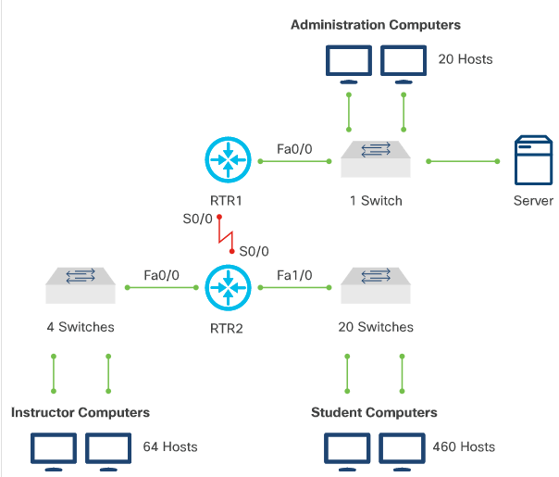
Network Devices Network Diagrams (Contd.)
A simplified Layer 2 network diagram is shown here.
This diagram gives a general idea of how the clients connect to the network and how the network devices connect to each other so that end to end connectivity between all clients is accomplished.
Notes:
5 – Network Fundamentals
5.4 – Network Devices
5.4.5 – Network Diagrams

Slide 48
Network Devices Packet Tracer – Explore a Simple Network
In this Packet Tracer, you will do the following:
Part 1: Add PCs to the Topology
Part 2: Test Connectivity Across the Network
Part 3: Create a Web Page and View it
Part 4: Examine the FIREWALL Access Lists
Notes:
5 – Network Fundamentals
5.4 – Network Devices
5.4.6 - Packet Tracer – Explore a Simple Network

Slide 49
5.5 Networking Protocols
Notes:
Source:
5 – Network Fundamentals
5.5 – Networking Protocols
In-Session Activities / Explanations:
Time: 25 min
Instructor Notes:
Introduce the topic and discuss about the standard network protocols.
Ensure that the learners understand different network protocols such as DHCP, DNS, SNMP, NTP
By the end of the topic, discuss with the learners about Network Address Translation.
Key Points: DHCP, DNS, SNMP, NTP, NAT

Slide 50
Networking Protocols Networking Protocols
It is essential to understand the standard network protocols for effective communication and troubleshooting.
Telnet and Secure Shell (SSH)
These protocols are used to connect and log into a remote computer.
SSH uses encryption to protect data over a network connection and hence is most frequently used.
Telnet should only be used in non-prod environments.
By default, SSH uses port 22 and Telnet uses port 23.
HTTP and HTTPS
HTTP stands for Hyper Text Transfer Protocol and HTTPS is the secure version of HTTP.
These protocols are recognized by web browsers and are used to connect to web sites.
HTTPS uses TLS or SSL to make a secure connection.
NETCONF and RESTCONF
NETCONF uses port 830. RESTCONF does not have a reserved port value.
To have multiple network operations, make sure each protocol has a default port and use standards to try to avoid conﬂicts.
Notes:
5 – Network Fundamentals
5.5 – Networking Protocols
5.5.1 – Networking Protocols

Slide 51
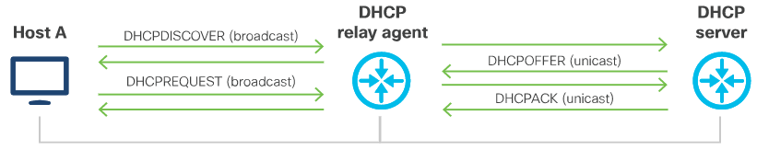
Networking Protocols DHCP
DHCP works within a client/server model, where DHCP servers allocate IP addresses and deliver conﬁguration information to devices that are configured to dynamically request addressing information.
In addition to the IP address for the device itself, a DHCP server can also provide additional information, like the IP address of the DNS server, default router, and other conﬁguration parameters.
Some of the beneﬁts of using DHCP instead of manual conﬁgurations are reduced client configuration tasks and costs and centralized management
DHCP allocates IP addresses in three ways: Automatic allocation, Dynamic allocation, Manual allocation.
DHCP Relay
In cases in which the DHCP client and server are located in different subnets, a DHCP relay agent can be used. A relay agent is any host that forwards DHCP packets between clients and servers.
Relay agents receive DHCP messages and then generate new DHCP messages on another interface.
Notes:
5 – Network Fundamentals
5.5 – Networking Protocols
5.5.2 – DHCP

Slide 52
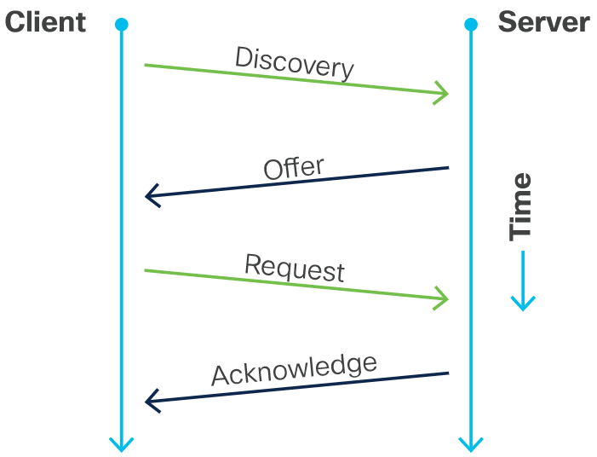
Networking Protocols DHCP (Contd.)
DHCP Operations
DHCP operations includes four messages between the client and the server:
DHCPDISCOVER - Server discovery
DHCPPOFFER - IP lease offer
DHCPREQUEST - IP lease request
DHCPACK - IP lease acknowledgment
The client broadcasts a DHCPDISCOVER message looking for a DHCP server..
The server responds with a unicast DHCPOFFER.
In case of multiple DHCP servers, it identifies the explicit server and broadcast a DHCPREQUEST message and lease offer.
The server sends a unicast DHCP acknowledgment message acknowledging to the client that the lease has been finalized.
Notes:
5 – Network Fundamentals
5.5 – Networking Protocols
5.5.2 – DHCP

Slide 53
Networking Protocols DNS
In data networks, devices are labeled with numeric IP addresses to send and receive data over networks. Domain names (DNS) were created to convert the numeric address into a simple, recognizable name.
The DNS protocol defines an automated service that matches domain names to IP addresses.
It includes the format for queries, responses, and data. DNS uses a single format called a DNS message.
DNS Message Format
The DNS server stores different types of resource records that are used to resolve names. Some of these record types are as follows:
A – An end device IPv4 address
NS – An authoritative name server
AAAA – An end device IPv6 address (pronounced quad-A)
MX – A mail exchange record
Notes:
5 – Network Fundamentals
5.5 – Networking Protocols
5.5.3 – DNS

Slide 54
Networking Protocols DNS (Contd.)
When a client makes a query to its configured DNS server, the DNS server first looks at its own records to resolve the name. If it is unable to resolve the name by using its stored records, it contacts other servers to resolve the name.
After a match is found and returned to the requesting server, the server temporarily stores the address in the event that the same name is requested again.
As shown in the following table, DNS uses the same message format between servers
DNS Message Section | Description
Question | The question for the name server
Answer | Resource Records answering the question
Authority | Resource Records pointing toward an authority
Additional | Resource Records holding additional information
Notes:
5 – Network Fundamentals
5.5 – Networking Protocols
5.5.3 – DNS

Slide 55
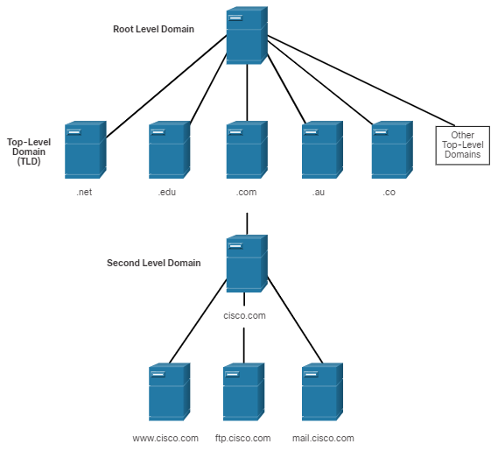
Networking Protocols DNS (Contd.)
DNS Hierarchy
DNS uses a hierarchical system based on domain names to create a database to provide name resolution.
The naming structure is broken down into small, manageable zones.
When a DNS server receives a request for a name translation that is not within its DNS zone, then it forwards the request to another DNS server within the proper zone for translation.
Notes:
5 – Network Fundamentals
5.5 – Networking Protocols
5.5.3 – DNS

Slide 56
Networking Protocols SNMP
SNMP was developed to allow administrators to manage devices such as servers, workstations, routers, switches, and security appliances, on an IP network.
SNMP is an application layer protocol that provides a message format for communication between managers and agents.
The SNMP system consists of three elements:
SNMP manager: network management system (NMS)
SNMP agents (managed node)
Management Information Base (MIB)
Notes:
5 – Network Fundamentals
5.5 – Networking Protocols
5.5.4 – SNMP

Slide 57
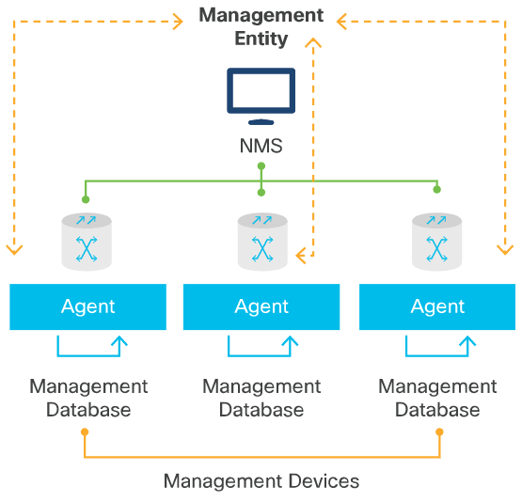
Networking Protocols SNMP (Contd.)
SNMP Components
To configure SNMP on a networking device, it is first necessary to define the relationship between the manager and the agent.
The SNMP manager is part of a network management system (NMS).
It can collect information from an SNMP agent by using the get action and can change configurations on an agent by using the set action.
Also, SNMP agents can forward information directly to the SNMP manager by using traps.
Notes:
5 – Network Fundamentals
5.5 – Networking Protocols
5.5.4 – SNMP

Slide 58
Networking Protocols SNMP (Contd.)
SNMP Operation
A SNMP agents running on a device collects and stores information about the device and its operation. The SNMP manager then uses the SNMP agent to access information within the MIB and make changes to the device configuration.
There are two primary SNMP manager requests, get and set. A get request is used by the SNMP manager to query the device for data. A set request is used by the SNMP manager to change configuration variables in the agent device.
SNMP Polling
The NMS can be configured to periodically have the SNMP managers poll the SNMP agents.
Using this process, the information is collected to monitor traffic loads and to verify the device configurations of managed devices.
The data can be graphed, or thresholds can be established to trigger a notification process when the thresholds are exceeded.
Notes:
5 – Network Fundamentals
5.5 – Networking Protocols
5.5.4 – SNMP

Slide 59
Networking Protocols SNMP (Contd.)
SNMP Traps
Periodic SNMP polling have some drawbacks.
delay between the time that an event occurs and the time that it is noticed (via polling) by the NMS
trade-off between polling frequency and bandwidth usage
To mitigate the disadvantages, SNMP agents generate and send traps to inform the NMS immediately of certain events.
SNMP Community Strings
For SNMP to operate, the NMS must have access to the MIB.
SNMPv1 and SNMPv2c use community strings (plaintext passwords) that control access to the MIB.
SNMP community strings authenticate access to MIB objects.
There are two types of community strings: Read-only (ro) and Read-write (rw)
Notes:
5 – Network Fundamentals
5.5 – Networking Protocols
5.5.4 – SNMP

Slide 60
Networking Protocols SNMP (Contd.)
Management Information Base (MIB)
MIBs are data structures that describe SNMP network elements as a list of data objects.
The MIB is organized in a tree-like structure with unique variables represented as terminal leaves.
An Object IDentiﬁer (OID) is a long numeric tag. It is used to distinguish each variable uniquely in the MIB and in the SNMP messages.
Variables that measure things such as CPU temperature, inbound packets on an interface, fan speed, and other metrics, all have associated OID values.
SNMP traps are used to generate alarms and events that are happening on the device. Traps contain:
OIDs that identify each event and match it with the entity that generated the event
Severity of the alarm (critical, major, minor, informational or event)
A date and time stamp
Notes:
5 – Network Fundamentals
5.5 – Networking Protocols
5.5.4 – SNMP

Slide 61
Networking Protocols SNMP (Contd.)
SNMP Communities
SNMP community names are used to group SNMP trap destinations.
When community names are assigned to SNMP traps, the request from the SNMP manager is considered valid if the community name matches the one conﬁgured on the managed device otherwise, SNMP drops the request.
SNMP Messages
SNMP uses the following messages to communicate between the manager and the agent:
Get and GetNext - The Get and GetNext messages are used when the manager requests information for a speciﬁc variable.
GetResponse - When the agent receives a Get or GetNext message it will issue a GetResponse message back to the manager.
Set - A Set message is used by the manager to request that a change should be made to the value of a speciﬁc variable.
Trap - The Trap message is used by the agent to inform the manager when important events take place.
Notes:
5 – Network Fundamentals
5.5 – Networking Protocols
5.5.4 – SNMP

Slide 62
Networking Protocols NTP
The main role of Network Time Protocol (NTP) is to synchronize the time of the devices on the network.
NTP enables a device to update its clock from a trusted network time source. A device receiving authoritative time can be conﬁgured to serve time to other machines, enabling groups of devices to be closely synchronized.
NTP runs over UDP using port 123 as source and destination.
An authoritative time source is usually a radio clock, or an atomic clock attached to a time server. Authoritative server in NTP is a very accurate time source. It is the role of NTP to distribute the time across the network.
NTP uses the concept of strata (layers) to describe how far away a host is from an authoritative time source. The most authoritative sources are in stratum 1.
Notes:
5 – Network Fundamentals
5.5 – Networking Protocols
5.5.5– NTP

Slide 63
Networking Protocols NTP (Contd.)
NTP avoids synchronizing with upstream servers whose time is not accurate by using these two ways:
NTP never synchronizes with a NTP server that is not itself synchronized.
NTP compares time reported by several NTP servers, and will not synchronize to a server whose time is an outlier.
Clients usually synchronize with the lowest stratum server they can access. But NTP incorporates safeguards as well: it prefers to have access to at least three lower-stratum time sources because this helps it determine if any single source is incorrect.
NTP Association Modes - NTP servers can associate in several modes, including:
Client/Server
Symmetric Active/Passive
Broadcast
Notes:
5 – Network Fundamentals
5.5 – Networking Protocols
5.5.5– NTP

Slide 64
Networking Protocols NTP (Contd.)
Client/Server Mode
This is the most common mode in which a client or dependent server can sync with a group member, but not the reverse, protecting against protocol attacks or malfunctions.
Client-to-server requests are made via asynchronous remote procedure calls.
In this mode, a client requests time from one or more servers and processes replies as received. The server changes addresses and ports, overwrites message ﬁelds, recalculates the checksum, and returns the message immediately.
Information included in the NTP message lets the client determine the skew between server and local time, enabling clock adjustment.
The message also includes information to calculate the expected timekeeping accuracy and reliability, as well as help the client select the best server.
Notes:
5 – Network Fundamentals
5.5 – Networking Protocols
5.5.5 – NTP

Slide 65
Networking Protocols NTP (Contd.)
Symmetric Active/Passive Mode
In this mode, a group of low stratum peers work as backups for one another. Each peer derives time from one or more primary reference sources or from reliable secondary servers.
Symmetric/active mode is usually conﬁgured by declaring a peer in the conﬁguration ﬁle, telling the peer that one wishes to obtain time from it, and provide time back if necessary.
Symmetric modes are most often used to interconnect two or more servers that work as a mutually redundant group.
Notes:
5 – Network Fundamentals
5.5 – Networking Protocols
5.5.5– NTP

Slide 66
Networking Protocols NTP (Contd.)
Broadcast and/or Multicast Mode
When only modest requirements for accuracy exist, clients can use NTP broadcast and/or multicast modes, where many clients are conﬁgured the same way, and one broadcast server (on the same subnet) provides time for them all.
Conﬁguring a broadcast server is done using the broadcast command, and then providing a local subnet address. The broadcast client command lets the broadcast client respond to broadcast messages received on any interface.
This mode cannot be used beyond a single subnet. This mode should always be authenticated because an intruder can impersonate a broadcast server and propagate false time values.
Notes:
5 – Network Fundamentals
5.5 – Networking Protocols
5.5.5– NTP

Slide 67
Networking Protocols NAT
Network Address Translation (NAT) helps with the problem of IPv4 address depletion. NAT works by mapping thousands of private internal IPv4 addresses to a range of public addresses.
NAT identifies trafﬁc to and from a speciﬁc device, translating between external/public and internal/private IPv4 addresses.
It enables an organization to easily change service providers or voluntarily renumber network resources without affecting their public IPv4 address space.
NAT also hides clients on the internal network behind a range of public addresses, providing a sense of security against the devices being directly attacked from outside.
Types of NAT
Static address translation (static NAT)
Dynamic address translation (dynamic NAT)
Overloading (also called Port Address Translation or PAT)
Notes:
5 – Network Fundamentals
5.5 – Networking Protocols
5.5.6 – NAT

Slide 68
Networking Protocols NAT (Contd.)
IPv6 was developed with the intention of making NAT unnecessary.
IPv6 provides protocol translation between IPv4 and IPv6. This is known as NAT64. NAT for IPv6 is used in a much different context than NAT for IPv4.
The varieties of NAT for IPv6 are used to transparently provide access between IPv6-only and IPv4-only networks.
Four NAT Addresses
NAT includes four types of addresses:
Inside address - This is the address of the device which is being translated by NAT.
Outside address - This is the address of the destination device.
Local address - This is any address that appears on the inside portion of the network.
Global address - This is any address that appears on the outside portion of the network.
Notes:
5 – Network Fundamentals
5.5 – Networking Protocols
5.5.6– NAT

Slide 69
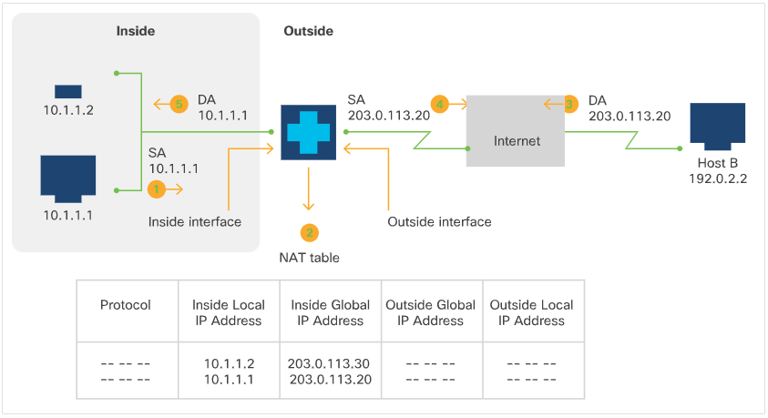
Networking Protocols NAT (Contd.)
Inside Source Address Translation
IPv4 addresses can be translated into globally-unique IPv4 addresses when communicating outside the internal network. There are two options to accomplish this:
Static translation - This method sets up a one-to-one mapping between an inside local address and an inside global address; useful when a host on the inside must be accessed from a ﬁxed outside address.
Dynamic translation - This method maps between inside local addresses and a global address pool.
The ﬁgure shows a device translating a source address inside a network to a source address outside the network
Notes:
5 – Network Fundamentals
5.5 – Networking Protocols
5.5.6 – NAT

Slide 70
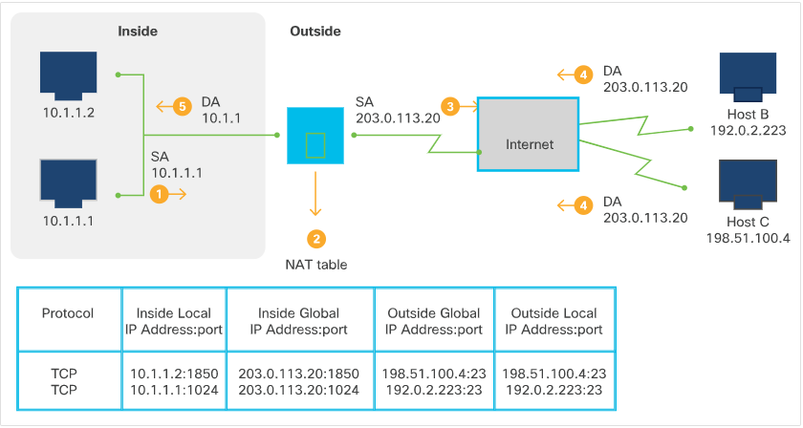
Networking Protocols NAT (Contd.)
Overloading of Inside Global Addresses
Using a single global address for multiple local addresses is known as overloading.
When overloading is conﬁgured, the NAT device gathers information from higher-level protocols (for example, TCP or UDP port numbers) to translate global addresses back to correct local addresses.
To map multiple local addresses to one global address, TCP or UDP port numbers are used to distinguish local addresses. This NAT process is called Port Address Translation (PAT).
Notes:
5 – Network Fundamentals
5.5 – Networking Protocols
5.5.6– NAT

Slide 71
Networking Protocols Packet Tracer – Explore Network Protocols
In this Packet Tracer, you will do the following:
Part 1: Configure DNS
Part 2: Configure DHCP
Part 3: Configure NTP
Part 4: Use SSH to Configure a Switch
Part 5: Use SNMP
Part 6: Configure HTTPS
Part 7: Configure EMAIL
Part 8: Configure FTP
Notes:
5 – Network Fundamentals
5.5 – Networking Protocols
5.5.7- Packet Tracer – Explore Network Protocols

Slide 72
5.6 Troubleshooting Application Connectivity Issues
Notes:
Source:
5 – Network Fundamentals
5.6 – Troubleshooting Application Connectivity Issues
In-Session Activities / Explanations:
Time: 20 min
Instructor Notes:
Introduce the topic and discuss troubleshooting application connectivity issues.
Discuss software utilities such as ifconfig, ping, traceroute, nslookup.
Key Points:
network connectivity issues, ifconfig, ping, nslookup, traceroute

Slide 73
Troubleshooting Application Connectivity Issues Troubleshooting Common Network Connectivity Issues
Network troubleshooting usually follows the OSI layers.
You can start either top to bottom beginning at the application layer and making your way down to the physical layer. Or you can go from the bottom to the top.
Solutions like Cisco AppDynamics can offer a deeper view into application performance and root cause analysis of application issues.
Notes:
5 – Network Fundamentals
5.6 – Troubleshooting Application Connectivity Issues
5.6.1 - Troubleshooting Common Network Connectivity Issues

Slide 74
Troubleshooting Application Connectivity Issues Troubleshooting Common Network Connectivity Issues (Contd.)
A typical troubleshooting session starting from physical layer and making our way up the stack of layers towards the application layer:
Determine how the client connects to the network - is it a wired or wireless connection?
If the client connects via an Ethernet cable, make sure the NIC comes online and there are electrical signals being exchanged with the switch port to which the cable is connected.
If the NIC is connected, the physical layer is working as expected.
If the NIC is not connected or enabled, check the conﬁguration on the switch. The port to which the client is connecting might be shut down, or maybe the cable connecting the client to the network port in the wall is defective, or the cable connecting the network port from the wall all the way to the switch might be defective.
Troubleshooting at the physical layer is to ensure that there are four uninterrupted pairs of twisted copper cables between the network client and the switch port.
If the client uses a wireless connection, check if the wireless network interface is turned on and make sure you stay in the range of the wireless access point.
Notes:
5 – Network Fundamentals
5.6 – Troubleshooting Application Connectivity Issues
5.6.1 - Troubleshooting Common Network Connectivity Issues

Slide 75
Troubleshooting Application Connectivity Issues Troubleshooting Common Network Connectivity Issues (Contd.)
Moving up to the data link layer, or Layer 2, ensure the client is able to learn destination MAC ensure that the addresses (using ARP) and also that the switch to which the client is connecting is able to learn the MAC addresses received in its ports.
If you can verify that the both these tables are accurate, then you can move to the next layer.
If the client cannot see any MAC addresses in its local ARP table, check for any Layer 2 access control lists on the switch port that might block this trafﬁc. Also ensure that the switch port is conﬁgured for the correct client VLAN.
At the network layer, or Layer 3, ensure the client obtains the correct IP address from the DHCP server, or is manually conﬁgured with the correct IP address and the correct default gateway.
If Layer 3 connectivity cannot be established, check IP access lists on the router interfaces, check the routing table on both the client and the default gateway router and make sure the trafﬁc is routed correctly.
If Layer 3 connectivity can be established all the way from the client to the destination, move on with troubleshooting to the transport layer, or Layer 4.
If Layer 3 connectivity cannot be established, check IP access lists on the router interfaces, check the routing table on both the client and the default gateway router and make sure the trafﬁc is routed correctly.
Notes:
5 – Network Fundamentals
5.6 – Troubleshooting Application Connectivity Issues
5.6.1- Troubleshooting Common Network Connectivity Issues

Slide 76
Troubleshooting Application Connectivity Issues Troubleshooting Common Network Connectivity Issues (Contd.)
If a transport connection cannot be established, verify ﬁrewalls and security appliances that are placed on the path of trafﬁc for rules that are blocking the trafﬁc based on TCP and UDP ports.
Verify if any load balancing is enabled and if the load balancer is working as expected, or if any proxy servers intercepting the trafﬁc are ﬁltering and denying the connection.
Trafﬁc load and network delay are the most difﬁcult to troubleshoot. Implementing QoS throughout the network can help with these issues.
If despite the network troubleshooting, you have not been able to identify any issue, there is a good chance that the problem is not with the network.
Notes:
5 – Network Fundamentals
5.6 – Troubleshooting Application Connectivity Issues
5.6.1- Troubleshooting Common Network Connectivity Issues

Slide 77
Troubleshooting Application Connectivity Issues Networking Tools – Using ifconfig
ifconfig is a software utility for UNIX-based operating systems. There is also a similar utility for Microsoft Windows-based operating systems called ipconfig.
The main purpose of this utility is to manage, conﬁgure, and monitor network interfaces and their parameters.
Ifconfig runs as a command-line interface tool and comes by default installed with most operating systems.
The common uses for ifconfig are:
Configure IP address and subnet mask for network interfaces.
Query the status of network interfaces.
Enable/disable network interfaces.
Change the MAC address on an Ethernet network interface.
Notes:
5 – Network Fundamentals
5.6 – Troubleshooting Application Connectivity Issues
5.6.2 - Networking Tools – Using ifconfig

Slide 78
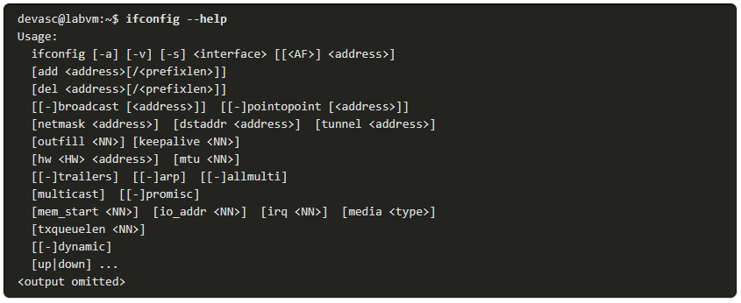
Troubleshooting Application Connectivity Issues Networking Tools – Using ifconfig (Contd.)
Issuing the ifconfig --help command in the command line interface will display all the options available with this version of ifconfig.
ifconfig gives us the option to add (add) or del (delete) IP addresses and their subnet mask (preﬁx length) to a speciﬁc network interface.
The hw ether gives us the option to change the Ethernet MAC address.
Notes:
5 – Network Fundamentals
5.6 – Troubleshooting Application Connectivity Issues
5.6.2 - Networking Tools – Using ifconfig

Slide 79
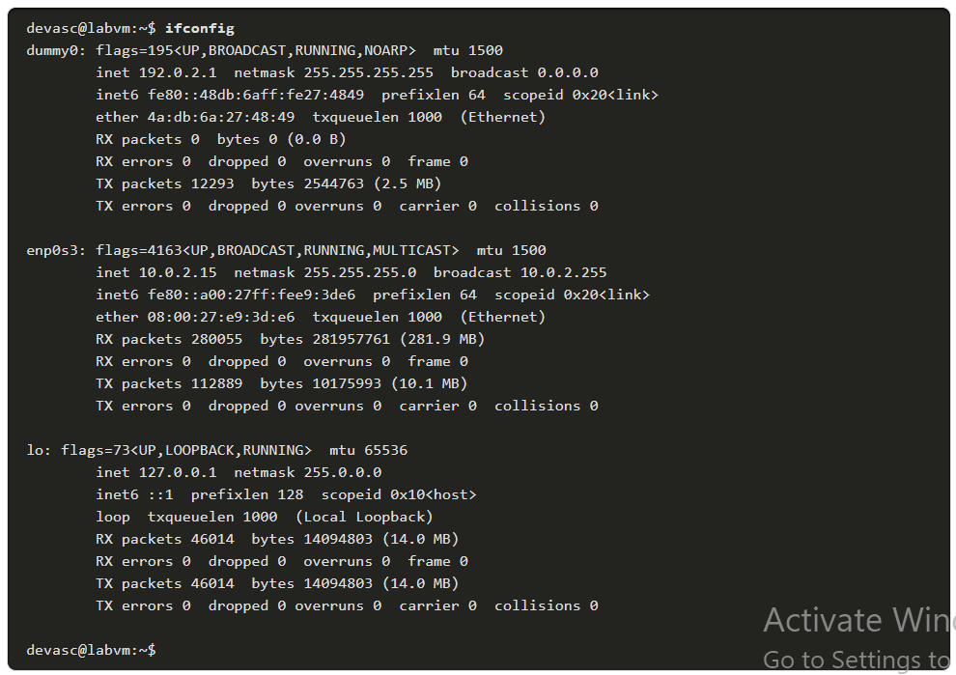
Troubleshooting Application Connectivity Issues Networking Tools – Using ifconfig (Contd.)
If ifconfig is issued without any parameters, it just returns the status of all the network interfaces on that host.
MTU is the Maximum Transmission Unit and speciﬁes the maximum number of bytes that the frame can be transmitted on this medium before being fragmented.
The RX packets and RX bytes contain the values of the received packets and bytes respectively on that interface.
Notes:
5 – Network Fundamentals
5.6 – Troubleshooting Application Connectivity Issues
5.6.2 - Networking Tools – Using ifconfig

Slide 80
Troubleshooting Application Connectivity Issues Networking Tools – Using ifconfig (Contd.)
The TX packets and TX bytes contain the values of transmit packets and bytes on that speciﬁc interface.
Note: The ifconfig command has been used within Linux for many years. However, some Linux distributions have deprecated the ifconfig command. The ip address command is becoming the new alternative. You will see the ip address command used in some of the labs in this course.
Notes:
5 – Network Fundamentals
5.6 – Troubleshooting Application Connectivity Issues
5.6.2 - Networking Tools – Using ifconfig

Slide 81
Troubleshooting Application Connectivity Issues Using ping
ping is a software utility used to test IP network reachability for hosts and devices connected to a speciﬁc network.
It is available virtually on all operating systems and is extremely useful for troubleshooting connectivity issues.
The ping utility uses Internet Control Message Protocol (ICMP) to send packets to the target host and then waits for ICMP echo replies.
Based on this exchange of ICMP packets, ping reports errors, packet loss, roundtrip time, Time To Live (TTL) for received packets, and so on.
Notes:
5 – Network Fundamentals
5.6 – Troubleshooting Application Connectivity Issues
5.6.3 - Using ping

Slide 82
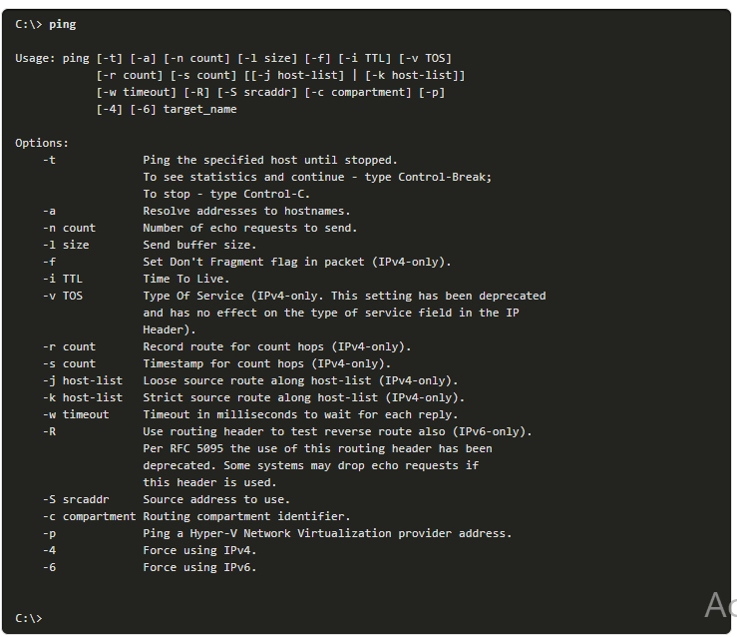
Troubleshooting Application Connectivity Issues Using ping (Contd.)
On Windows 10, enter the ping command to view its usage information.
The output should look similar to the figure alongside.
Notes:
5 – Network Fundamentals
5.6 – Troubleshooting Application Connectivity Issues
5.6.3 - Using ping

Slide 83
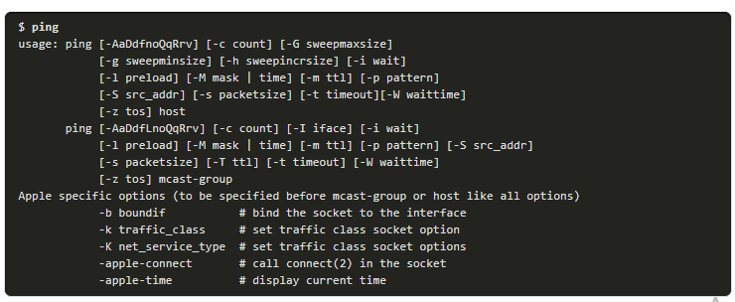
Troubleshooting Application Connectivity Issues Using ping (Contd.)
On MacOS Catalina, enter the ping command to view its usage information.
The output should look similar to the following:
Notes:
5 – Network Fundamentals
5.6 – Troubleshooting Application Connectivity Issues
5.6.3 - Using ping

Slide 84
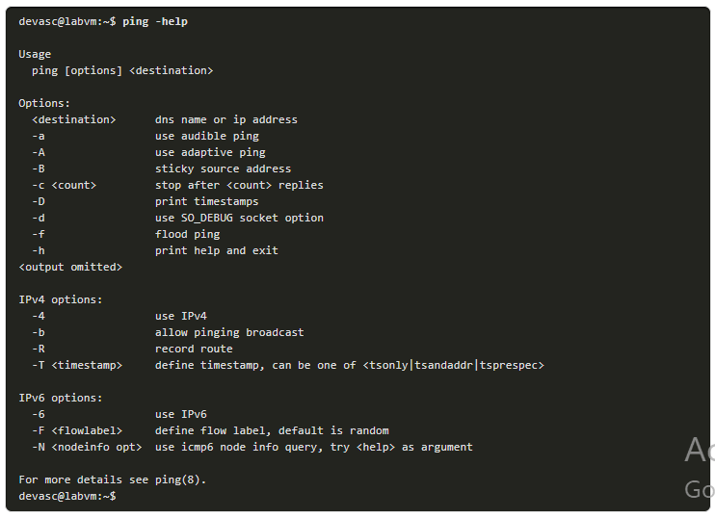
Troubleshooting Application Connectivity Issues Using ping (Contd.)
On your DEVASC VM, add the -help option to view its usage information.
The output should look similar to the figure alongside.
Notes:
5 – Network Fundamentals
5.6 – Troubleshooting Application Connectivity Issues
5.6.3 - Using ping

Slide 85
Troubleshooting Application Connectivity Issues Using ping (Contd.)
By default, ping (or ping -help in Linux) will display all the available options. Some of the options you can specify include:
Count of how many ICMP echo requests you want to send.
Source IP address in case there are multiple network interfaces on the host
Timeout to wait for an echo reply packet
Packet size, if you want to send larger packet sizes than the default 64 bytes. This option is very important when determining what is the MTU on an interface.
If you do not receive any reply from the destination you are trying to reach with ping, it does not mean that the host is ofﬂine or not reachable. It could simply mean that ICMP echo-request packets are ﬁltered by a ﬁrewall and are not allowed to reach the host destination.
Notes:
5 – Network Fundamentals
5.6 – Troubleshooting Application Connectivity Issues
5.6.3 - Using ping

Slide 86
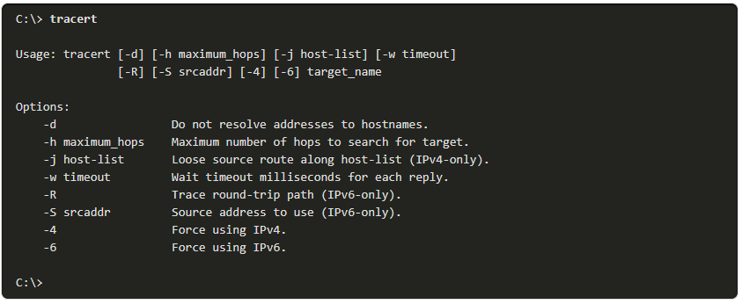
Troubleshooting Application Connectivity Issues Using traceroute
traceroute displays the route that the packets take to display the host reachability on the network.
traceroute uses ICMP packets to determine the path to the destination.
On Windows 10, use tracert to see the available options as shown in the output alongside.
Note: Instead of ICMP, by default, Linux uses UDP and a high port range (33434 - 33534). Destinations along the path respond with ICMP port unreachable messages instead of the echo replies sent in ICMP-based traceroutes.
Notes:
5 – Network Fundamentals
5.6 – Troubleshooting Application Connectivity Issues
5.6.4 - Using traceroute

Slide 87
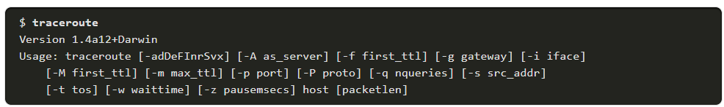
Troubleshooting Application Connectivity Issues Using traceroute (Contd.)
On MacOS, use traceroute to see the available options as shown in the following output:
Notes:
5 – Network Fundamentals
5.6 – Troubleshooting Application Connectivity Issues
5.6.4 - Using traceroute

Slide 88
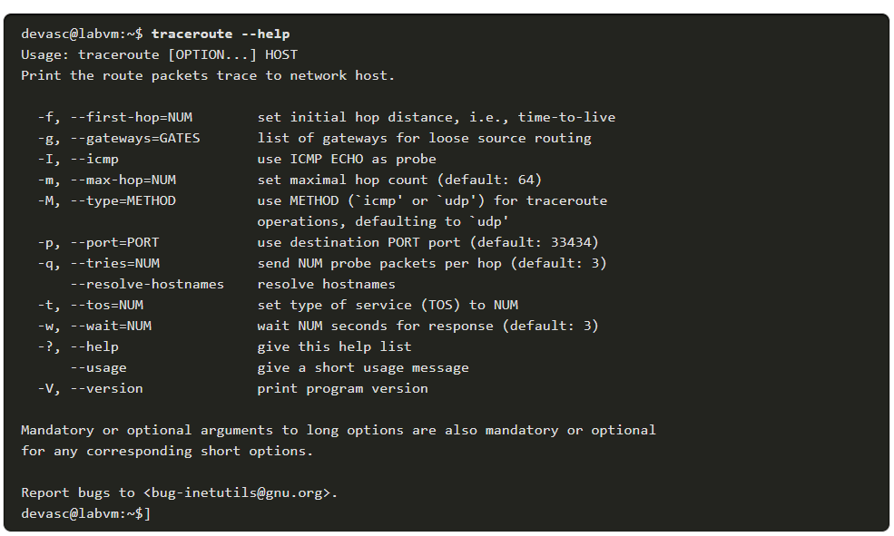
Troubleshooting Application Connectivity Issues Using traceroute (Contd.)
On your DEVASC VM, use traceroute --help to see the available options as shown in the following output:
Notes:
5 – Network Fundamentals
5.6 – Troubleshooting Application Connectivity Issues
5.6.4 - Using traceroute

Slide 89
Troubleshooting Application Connectivity Issues Using traceroute (Contd.)
Several options are available with traceroute including:
Specifying the TTL value of the first packet sent. By default this is 1.
Specifying the maximum TTL value. By default, it will increase the TTL value up to 64 or until the destination is reached.
Specifying the source address in case there are multiple interfaces on the host.
Specifying QoS value in the IP header.
Specifying the packet length.
Notes:
5 – Network Fundamentals
5.6 – Troubleshooting Application Connectivity Issues
5.6.4 - Using traceroute

Slide 90
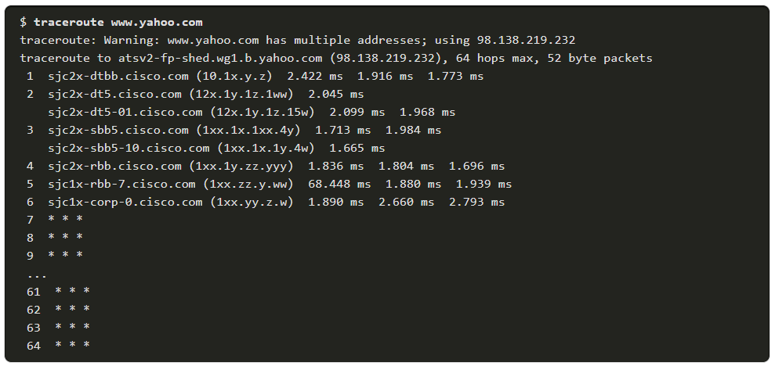
Troubleshooting Application Connectivity Issues Using traceroute (Contd.)
You can tracert from your Windows device or traceroute from your MacOS device.
The output alongside is from a MacOS device inside the corporate Cisco network tracing the route to one of Yahoo’s web servers.
Note: The output above has been altered for security reasons, but your output should actually have both valid hostnames and IP addresses.
Notes:
5 – Network Fundamentals
5.6 – Troubleshooting Application Connectivity Issues
5.6.4 - Using traceroute

Slide 91
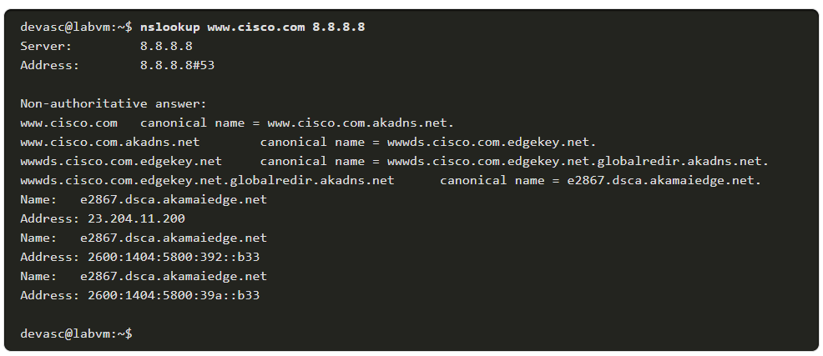
Troubleshooting Application Connectivity Issues Using nslookup
nslookup is another command-line utility used for querying DNS to obtain domain name to IP address mapping. This tool is useful to determine if the DNS server conﬁgured on a speciﬁc host is working as expected and actually resolving hostnames to IP addresses.
Execute the command nslookup www.cisco.com 8.8.8.8 to resolve the IP address or addresses for Cisco’s web server and specify that you want to use Google’s DNS server at 8.8.8.8 to do the resolution.
Notes:
5 – Network Fundamentals
5.6 – Troubleshooting Application Connectivity Issues
5.6.5 - Using nslookup

Slide 92
Troubleshooting Application Connectivity Issues Packet Tracer – Troubleshoot Common Network Problems
In this Packet Tracer, you will complete these objectives:
Part 1: Test connectivity
Part 2: Troubleshoot R3
Part 3: Troubleshoot R1
Part 4: Troubleshoot DNS
Notes:
5 – Network Fundamentals
5.6 – Troubleshooting Application Connectivity Issues
5.6.6 - Packet Tracer – Troubleshoot Common Network Problems

Slide 93
Troubleshooting Application Connectivity Issues Lab – Network Troubleshooting Tools
In this lab, you will do the following:
Part 1: Launch the DEVASC VM
Part 2: Explore the ifconfig Troubleshooting Tool
Part 3: Explore the ping Troubleshooting Tool
Part 4: Explore the traceroute Troubleshooting Tool
Part 5: Explore the nslookup Troubleshooting Tool
Notes:
5 – Network Fundamentals
5.6 – Troubleshooting Application Connectivity Issues
5.6.7 - Lab – Network Troubleshooting Tools

Slide 94
5.7 Networking Fundamentals Summary
Notes:
Cisco Networking Academy Program
DevNet Associate v1.0
5 – Network Fundamentals
5.7 – Networking Fundamentals Summary
In-Session Activities / Explanations:
Time: 2 min
Instructor Notes:
Summarize the module by giving brief overview of all topics covered in this module.
Key Points:
NA

Slide 95
Networking Fundamentals Summary What Did I Learn in this Module?
A network consists of end devices such as computers, mobile devices, and printers that are connected by networking devices such as switches and routers.
Both the OSI and the TCP/IP reference models use layers to describe the functions and services that can occur at that layer.
All network devices on the same network must have a unique MAC address.
Every device on a network has a unique IP address. An IP address and a MAC address are used for access and communication across all network devices.
While switches are used to connect devices on LAN, routers are used to route trafﬁc between different networks.
A ﬁrewall is a hardware or software system that prevents unauthorized access into or out of a network.
Notes:
5 – Network Fundamentals
5.7 – Networking Fundamentals Summary
5.7.1 - What Did I Learn in this Module?

Slide 96
Networking Fundamentals Summary What Did I Learn in this Module? (Contd.)
Load balancing improves the distribution of workloads across multiple computing resources, such as servers, cluster of servers, network links, and so on.
Server load balancing helps ensure the availability, scalability, and security of applications and services by distributing the work of a single server across multiple servers.
Network diagrams display a visual and intuitive representation of the network.
There are multiple network operations that use different protocols such as SSH, Telnet, DNS, http, NETCONF and RESTCONF. Each protocol has a default port.
ping is a software utility used to test IP network reachability for hosts and devices connected to a speciﬁc network.
traceroute uses ICMP packets to determine the path to the destination.
nslookup is another command-line utility used for querying DNS to obtain domain name to IP address mapping.
Notes:
5 – Network Fundamentals
5.7 – Networking Fundamentals Summary
5.7.1 - What Did I Learn in this Module?

Slide 97
Module 5 New Terms and Commands
Protocol Data Unit (PDU) Medium Access Control (MAC) layer Logical Link Control (LLC) layer Remote Procedure Calls (RPCs) Secure Shell (SSH) | Enhanced Interior Gateway Routing Protocol (EIGRP) Start of frame delimiter (SFD) Frame Check Sequence (FCS) Network Time Protocol (NTP) Management Information Base (MIB) | Global Unicast Address (GUA) Cyclic Redundancy Check (CRC) Cisco Express Forwarding (CEF) Port Address Translation (PAT)
Notes:
5 – Network Fundamentals
New Terms and Commands

